Slide 1



Smart Contracts and dezentralized Blockchain Applications
Smart Contracts and Decentralized Blockchain Applications
DISCLAIMER:
Please check the link in the chat
Make sure your metamask is activated & connected to Ropsten Testnet
A presentation by Franco Restelli, Lukas Reffay, Leonard Kimmling and Janina Elsässer
3rd of December 2021
A presentation by Franco Restelli, Lukas Reffay, Leonard Kimmling and Janina Elsässer
3rd of December 2021

Slide 2
Use Case: Clubs
Use Case
Club members have to vote every year, which persons should be in the club board
Problem
Nontransparent governance and elections, manipulation of process is possible
Solution
Smart contract implementation to improve transparency and security in the voting process
Note: We’ve made simplifying assumptions (simple structure, no transaction costs and no special rights within the running structure)

Slide 3

Who is in the contract (initially)?

Slide 4



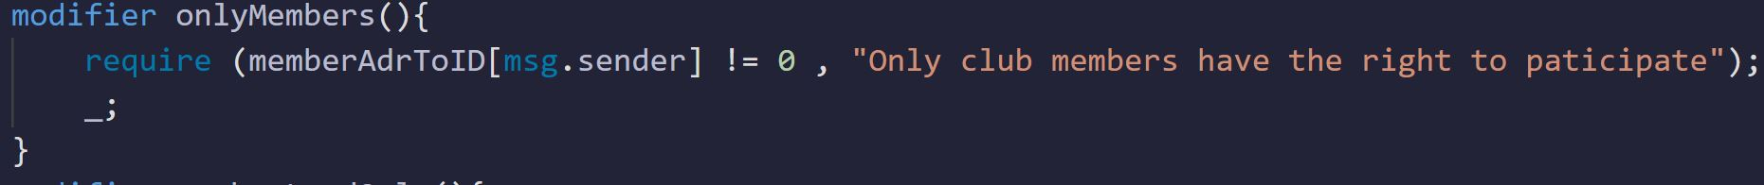
Who has rights within the contract?
Only club members have the right to participate

Slide 5
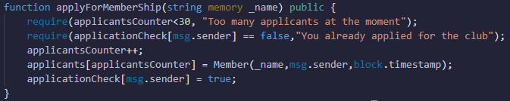
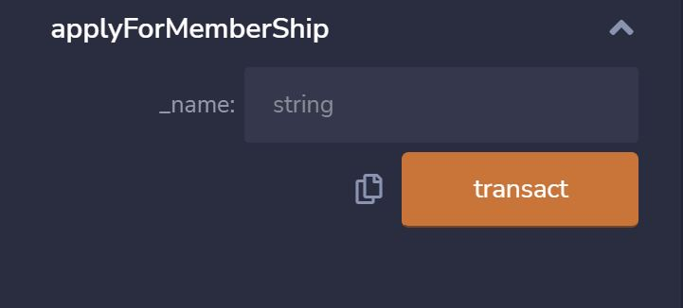
Application process for a club membership

Slide 6

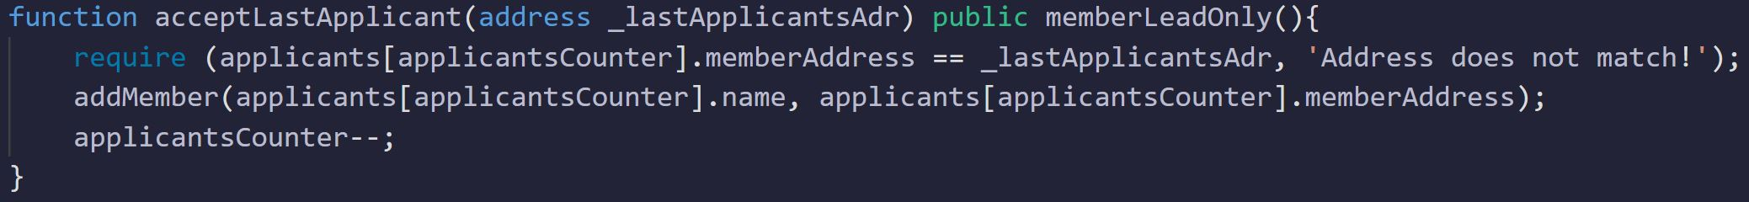
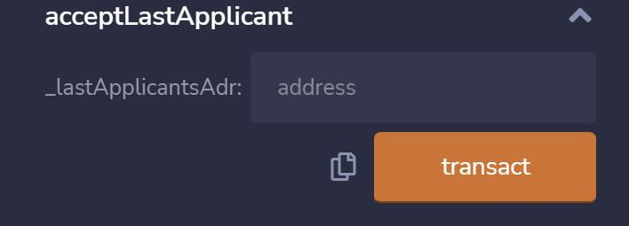
Approval of a club membership

Slide 7

Voting a new club board via a smart contract
Much more relevant is the function of a voting process via the smart contract on a new club board, thus we are gonna show this one hands on within remix

Slide 8
Limitations and potential extensions
LIMITATIONS
EXTENSIONS
Approval of candidates is not fully decentralized
→ Prone to collusion between leaders
Gas fees
Limited functionality
Could be extended to club investments voting
Management of membership fees and club funds

Slide 9


Q&A
Notes:
arton

Slide 10
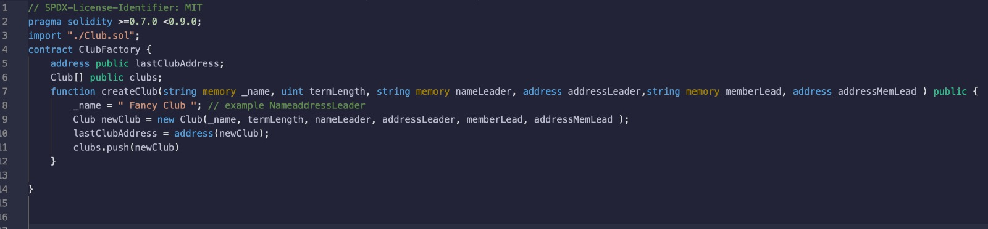
Appendix 1: Contract Factory

Slide 11
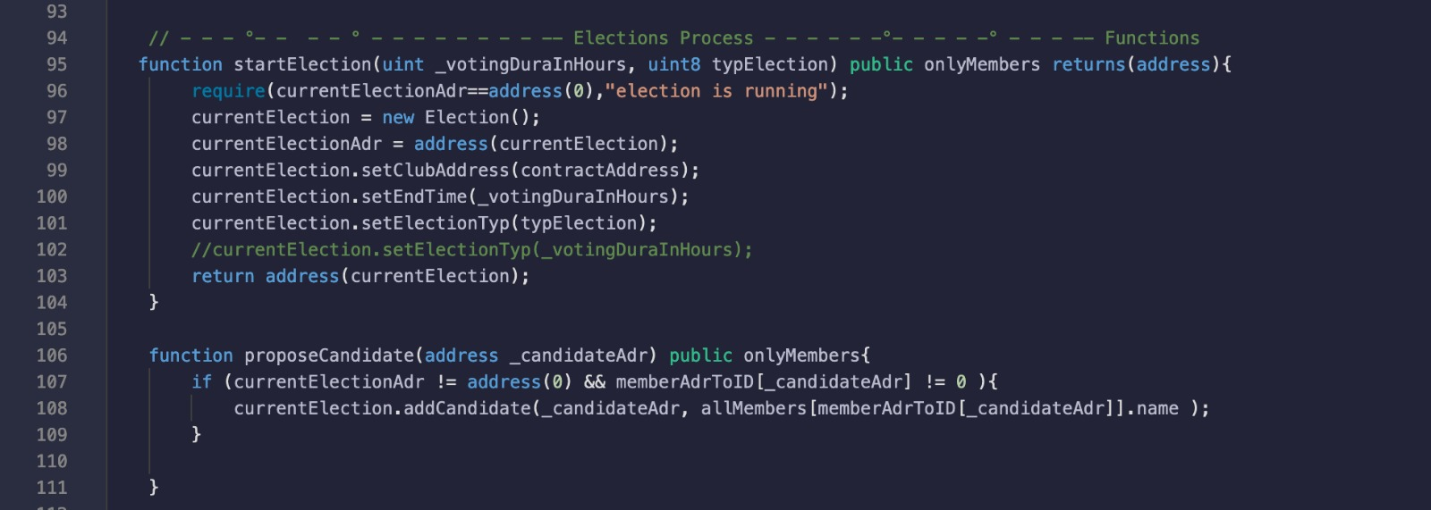
Appendix 2: Election

